Slide 1
How to Code today.php

Slide 2
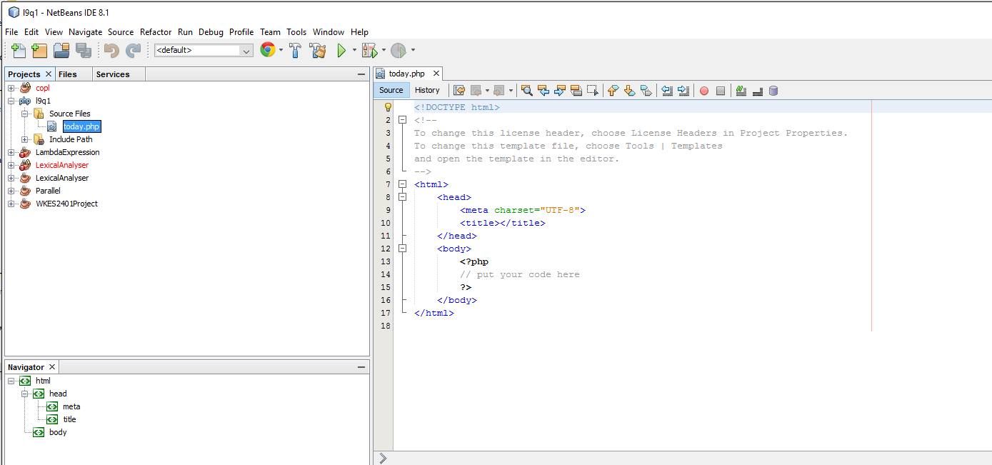
Create a PHP Project in NetBeans

Slide 3
Write Code as Below
<html>
<head>
<meta charset="UTF-8">
<title></title>
</head>
<body>
<p>
<?php
print "Welcome to the class <br />";
print "Today is:";
print date("1, F jS");
print "<br />";
?>
</p>
</body>
</html>

